Slide 1
EE 331 : Research and Development project
Design of CMOS rectifier for RF energy harvesting & RF receiver mixer for NB-IOT devices.
Miriyala Pranay Kamal
200030033
Professor in charge : Prof Nagaveni S

Slide 2
Our weekly plan and progress - 1
Week 1 - First meeting, CMOS rectifier paper reading, and going through basic components of a rectifier - matching impedance, Rectifier circuit and boost converter.
Week 2 - Getting started with Cadence Virtuoso, SImulating a basic voltage divider circuit.
Week 3 - Cadence virtuoso simulation of CMOS rectifier topology, and fine tuning an appropriate matching impedance network.
Week 4 - Sweep analysis on the inductor and capacitor values for the increasing the gain of the CMOS rectifier circuit and fine tuning the matching impedance network.
Week 5 - S parametric analysis of the circuit from 500 MHz to 3 GHz for verifying if the impedance matching network is giving us the lowest impedance at 2.2 GHz.

Slide 3
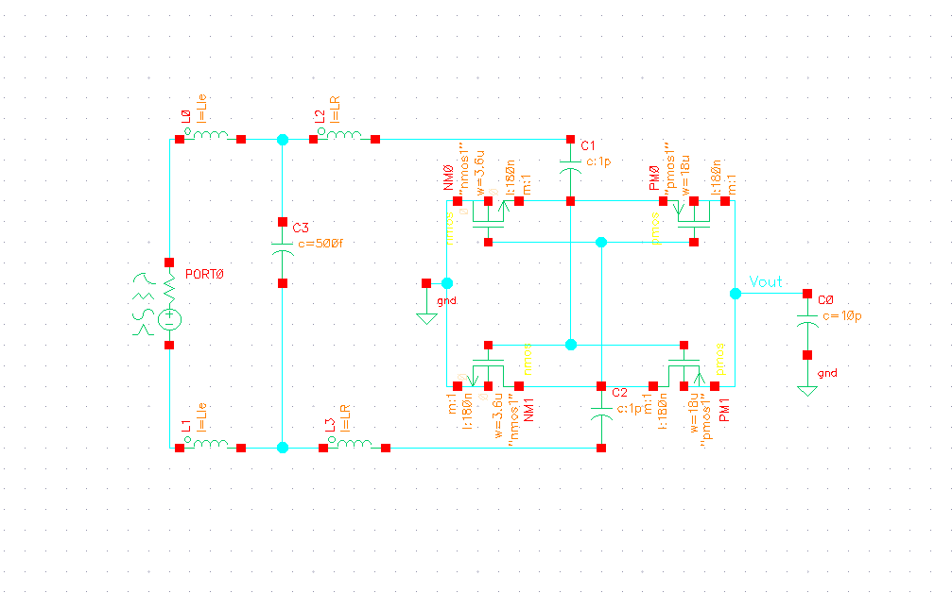
Matching impedance network values:
L1 = 5nH
L2 = 30nH
C = 0.5nF
Input power = -10 dB
Frequency = 2.2 GHz
V_{out} observed with a capacitive load.
CMOS rectifier topology circuit implemented in virtuoso
Notes:
Q.How does the CMOS rectifier work ?
Ans. It works similar to the Full wave rectifier.

Slide 4
Results after simulating the circuit in Cadence Spectre - Analog design environment L(ADE L)
OUTPUT VOLTAGE - TRANSIENT
FREQUENCY SWEEP FROM 500 MHz TO 3GHz - PARAMETRIC
POWER SWEEP FROM 0 TO -30 dBm - PARAMETRIC
S PARAMETER ANALYSIS 500 MHz TO 3GHz - SP ANALYSIS

Slide 5
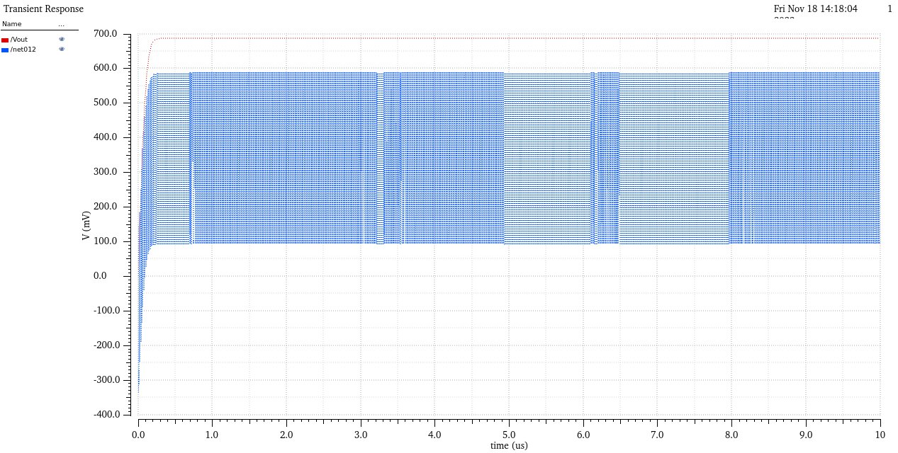
Legend
V_{out} - RED
V_{RF} - BLUE
Input power for the signal is -10 dBm
V_{output} & V_{RF} vs time - transient analysis = 0 -10 µs

Slide 6
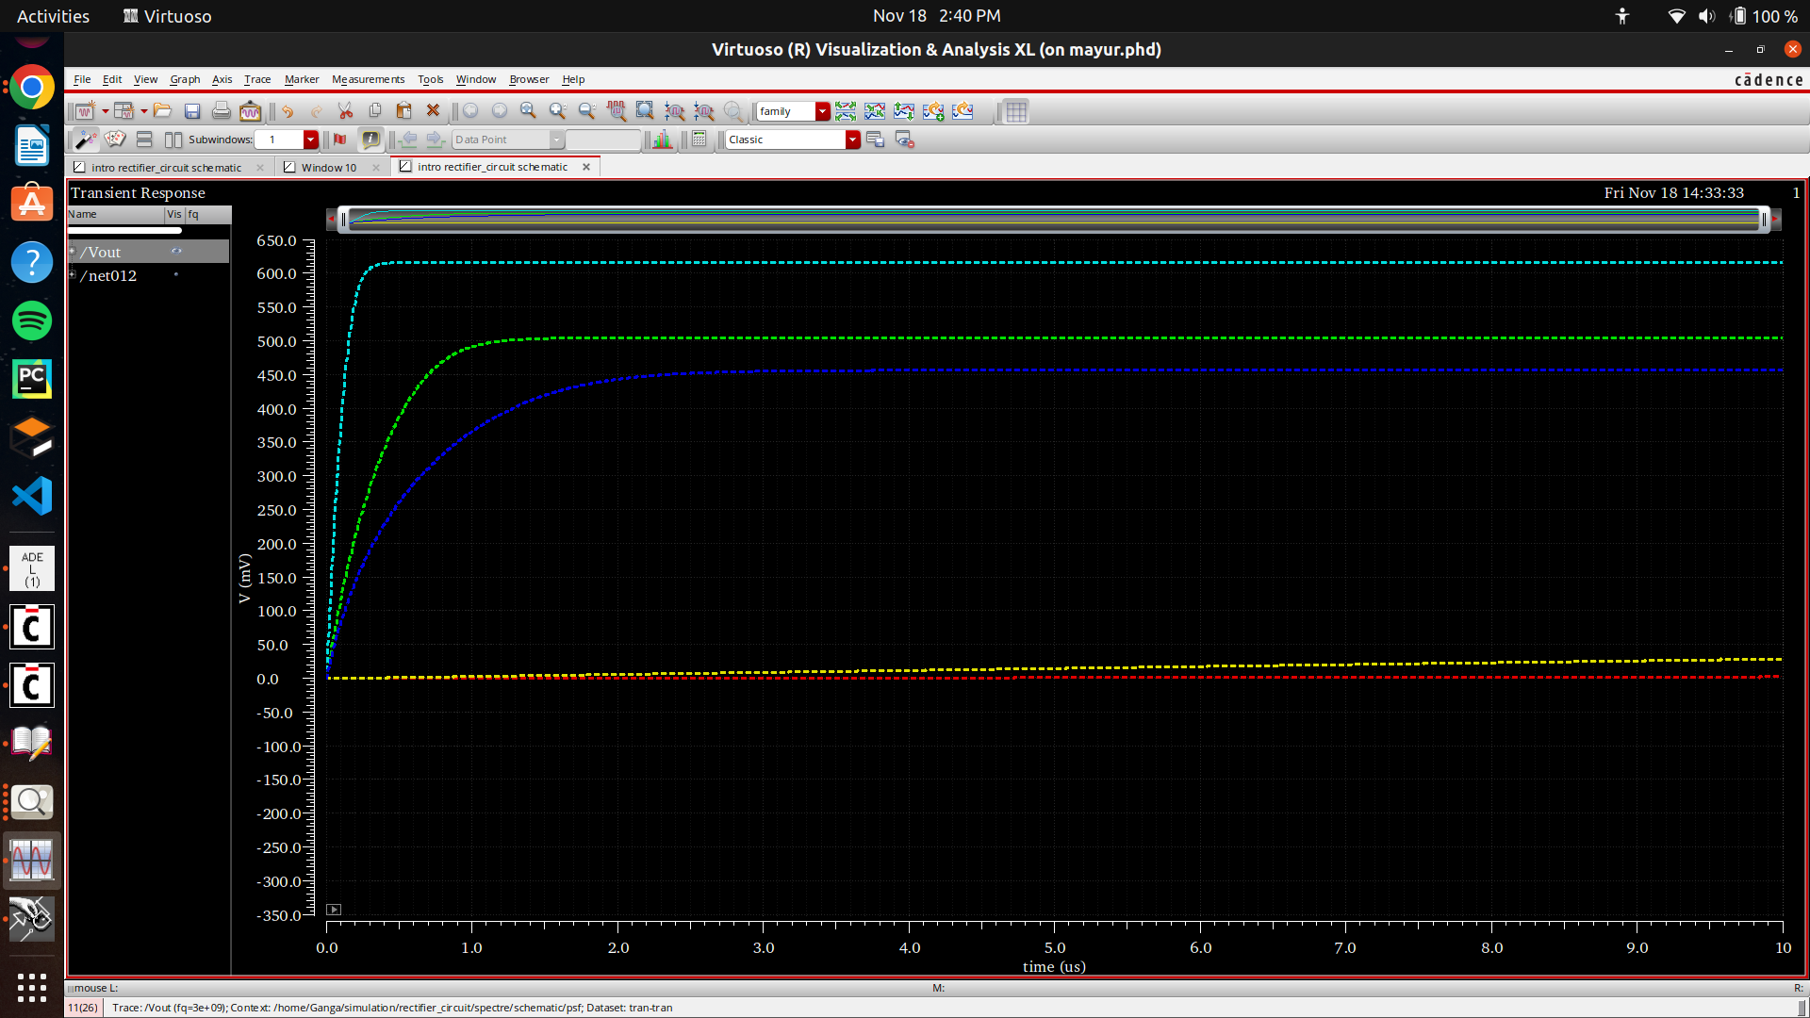
Legend:
Frequency
0.5 G - orange
1.25 G - yellow
1.75 G - green
2.375 G - blue
3 G - dark blue
Frequency Sweep from 500 MHz to 3GHz

Slide 7
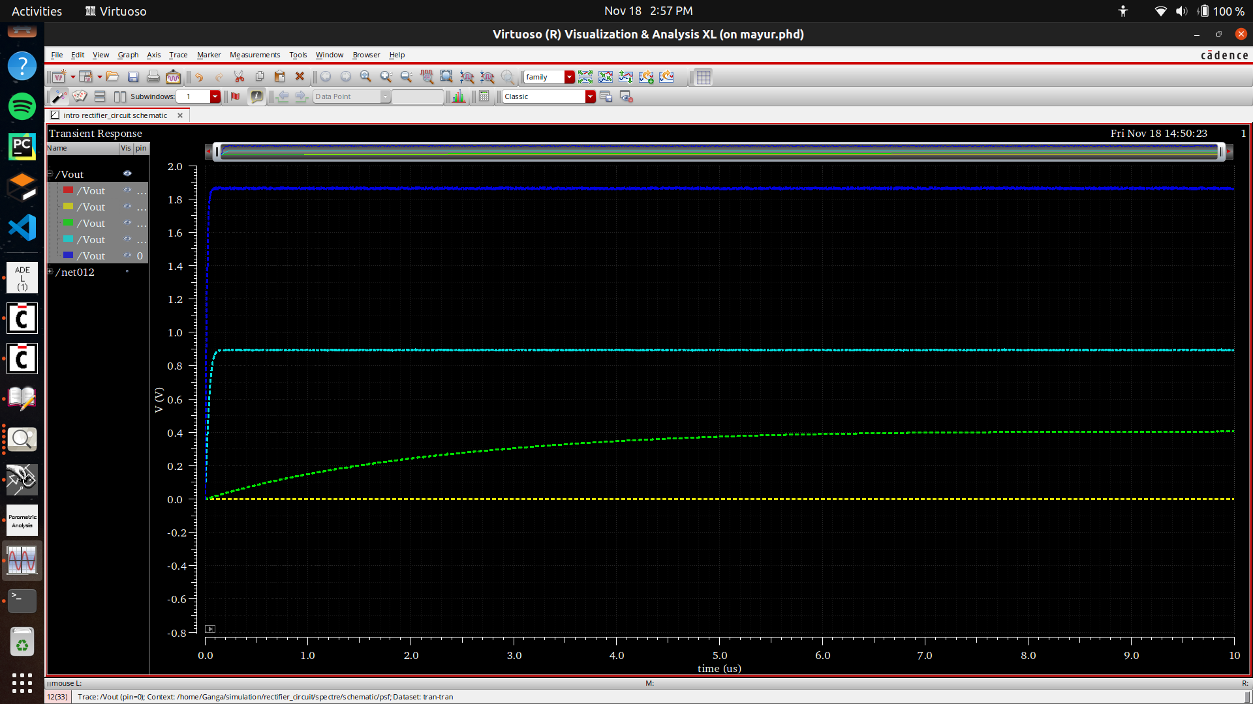
Legend:
Power
0 - dark blue : 1.87 V
-7.5 - blue : 0.894 V
-15 - green : 0.4 V
-22.5 - yellow : 1.44 mV
-30 - red : 408.2 nV
Power Sweep from 0 to -30 dBm - parametric

Slide 8
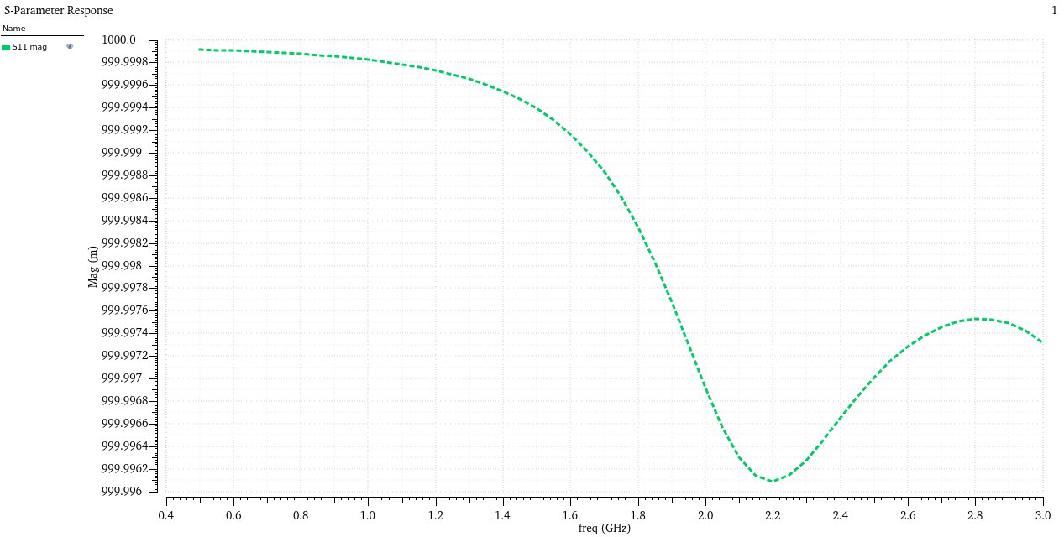
S parametric analysis from 0 to -30 dBm

Slide 9
Our weekly plan and progress - 2
Week 6 - Basics of current mirror circuits using NMOS and blocks in Radio frequency Integrated circuits (RFICs) for implementation of RF receiver for NB-IOT(Narrow band IOT).
Week 7 - Lectures on Mixers by Prof Yatendra Singh, Associate professor, IIT patna
Week 8 - Analysis of NMOS based gilbert cell mixer, and netlisting the circuit on Cadence virtuoso, both single ended and differential circuits.
Week 9, 10 - Biasing the RF NMOS, LO NMOS, Current mirror NMOS in saturation mode for Mixer circuit in Cadence spectre by dc analysis in Cadence spectre.
Week 11 - providing radio frequency(RF) = 900 MHz, local oscillator(LO) = 1 GHz signals to the mixer and observing the IF(intermediate frequency) output through transient, pss, pca analysis in Cadence spectre.
Week 12 - providing radio frequency(RF) = 900 MHz, local oscillator(LO) = 1 GHz signals to the mixer and trying to get the output vs LO power plots using pss and pca analysis.

Slide 10
Technology used in our circuit simulations
We preferred Taiwan Semiconductor Manufacturing Company Limited (TSMC) - 65 nanometer technology in Cadence virtuoso software for MOSFETS.
TSMC's 65nm technology is the Company's third-generation semiconductor process and introduced a broad process portfolio that includes:
general purpose (GP)
mixed signal/radio frequency (MS/RF)
embedded DRAM memory (eDRAM)
multi-time programmable non-volatile memory (MNVM)
embedded flash memory (eFLASH)
high voltage (HV)
Power management (BCD) and MEMS processes.
The 65nm technology supports for a wide range of applications, such as mobile devices, computers, automotive electronics, IoT, and smart wearables.

Slide 11
MIXERS in RFICs

Slide 12
What is a mixer and how is it different from an amplifier ?
Amplifiers change the amplitude of the signal, whereas mixers change the frequency of the input signal.
A mixer is a 3 terminal block, which has RF(input), LO(local oscillator), IF(intermediate frequency) pins.
Mixer is an element which modifies the frequency of the input signal.

Slide 13
Using a non-linear device : diodes, current through MOSFETs in saturation mode.
Mixers
Using a switch : MOSFETs
Two ways of realizing a mixer
Notes:
Hi my name is Pranay.. Nenu eripoku nii..Hello frands

Slide 14

About mixers and classification based on various parameters in mixers
There are two possibilities in mixing the RF signal with LO signal
⍵_{RF} > ⍵_{IF} : Receiver path, Down conversion mixer
⍵_{RF} < ⍵_{IF} : Transmitter path, Up conversion mixer
Also mixers are classified according to the output gain (IF) w.r.t the input signal (RF)
O/P > I/P : active mixers
O/P < I/P : passive mixers

Slide 15
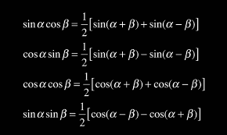
Mathematics behind mixers
V_{RF}(t) = A.cos(⍵_{RF}t) & V_{LO}(t) = B.cos(⍵_{LO}t) are the input signals (radio frequency and local oscillator).
The basic identity that aids us in mixing two signals is to multiply these two signals and the output after the multiplication will be:
V_{RF}(t) ✖ V_{LO}(t) = (AB/2) ✖ [cos((⍵_{RF}+ ⍵_{LO})t) + cos((⍵_{RF} - ⍵_{LO})t)]
We get both ⍵_{RF}+ ⍵_{LO} and ⍵_{RF} - ⍵_{LO} (up converted and down converted) frequencies in the multiplication of 2 sinusoids of different frequencies.

Slide 16
Characteristics of mixers
Conversion Gain/ Loss : This parameter determines if the mixer is an active or a passive mixer. An active mixer has an external power supply, and it produces a conversion gain, whereas a passive mixer doesn’t have a power supply and it produces a conversion loss.
Port-Port feedthrough : The three ports on the mixer, namely RF, LO, IF frequency ports are fed through unintentionally, and this is due to mutual inductances in the Diode ring mixer and the MOS parasitic capacitances in the Gilbert cell mixer.
Noise figure : The amount of noise each port contributes to is called the noise figure.

Slide 17
MIxers
Balanced mixers
Unbalanced mixers
Single balanced
Double balanced
Classification of mixers based on the feedthrough

Slide 18
Classification of mixers based on ports
1
2
3
Unbalanced mixer
Single balanced mixer
Double balanced mixer
Has more possibility of leakage / feedthrough due to all the ports being single ended ports.
Differential inputs at LO, IF pins and a single ended input at RF pins.
Differential inputs at all the three pins of the mixer.
RF, LO, IF ports are single ended
An example of such unbalanced mixer is Single Diode Modulator Circuit.
An example of single balanced mixer is Two Diode Single Balanced Mixer.
LO to RF leakage is still possible in this topology.
It suppresses both the RF signal and LO at the output.
An example fo double balanced mixer is Double Balanced Diode Ring Mixer.

Slide 19
Circuits simulated for the mixer component in Cadence virtuoso are:
SINGLE BALANCED MIXER - RF(single ended - ground referenced inputs), LO(differential inputs).
DOUBLE BALANCED MIXER - RF, LO are differential ended inputs
Ideal Balun circuit - converts single ended circuits into differential circuits.

Slide 20
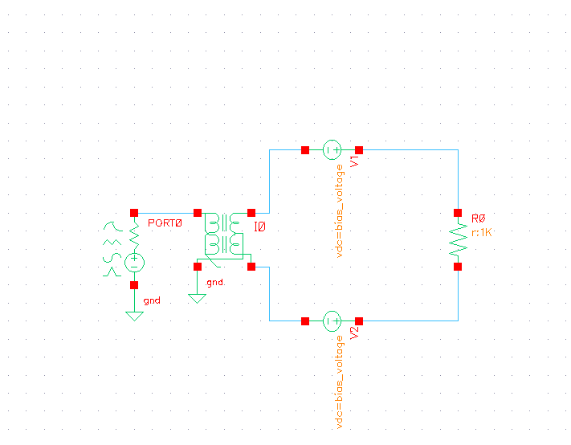
Ideal Balun test bench - from Analoglib

Slide 21
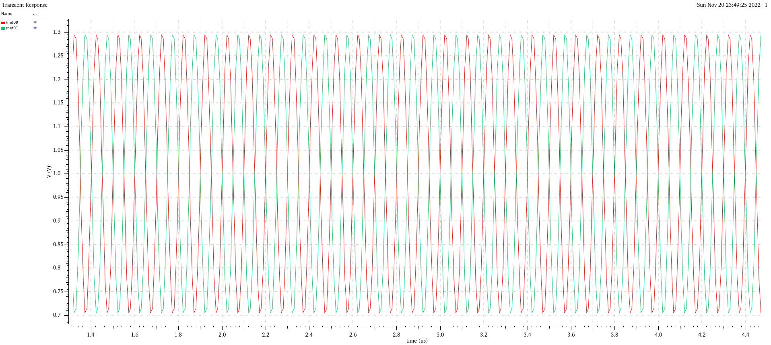
Input - single ended ground referenced signal & Output - differential signal with 180 degrees phase shift.

Slide 22
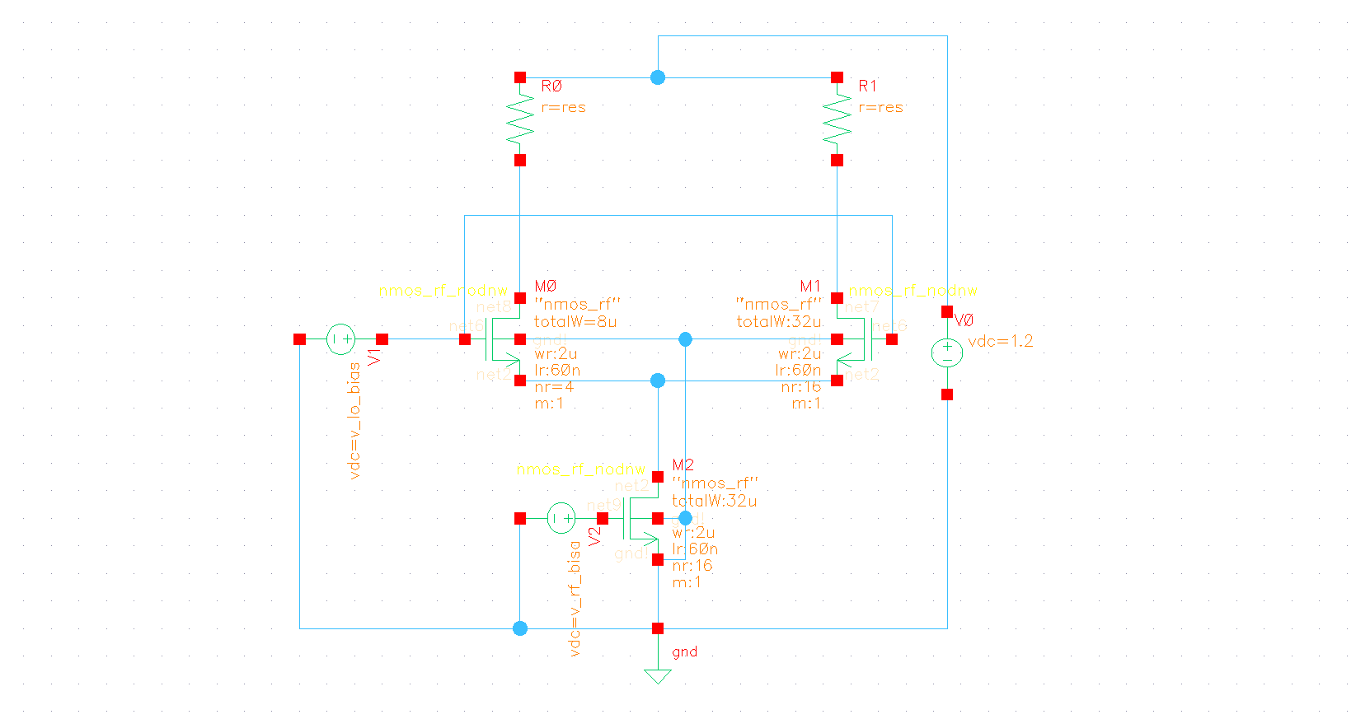
Single balanced mixer circuit

Slide 23
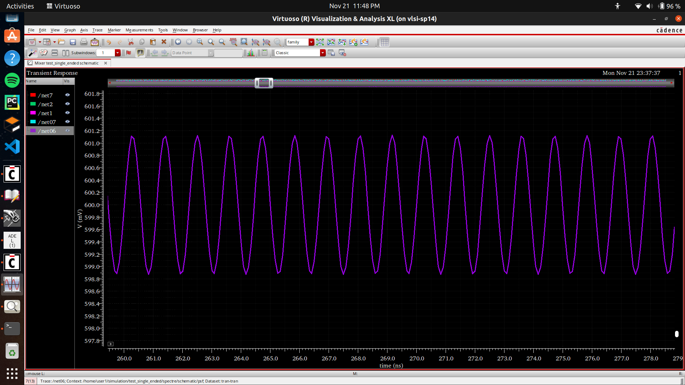
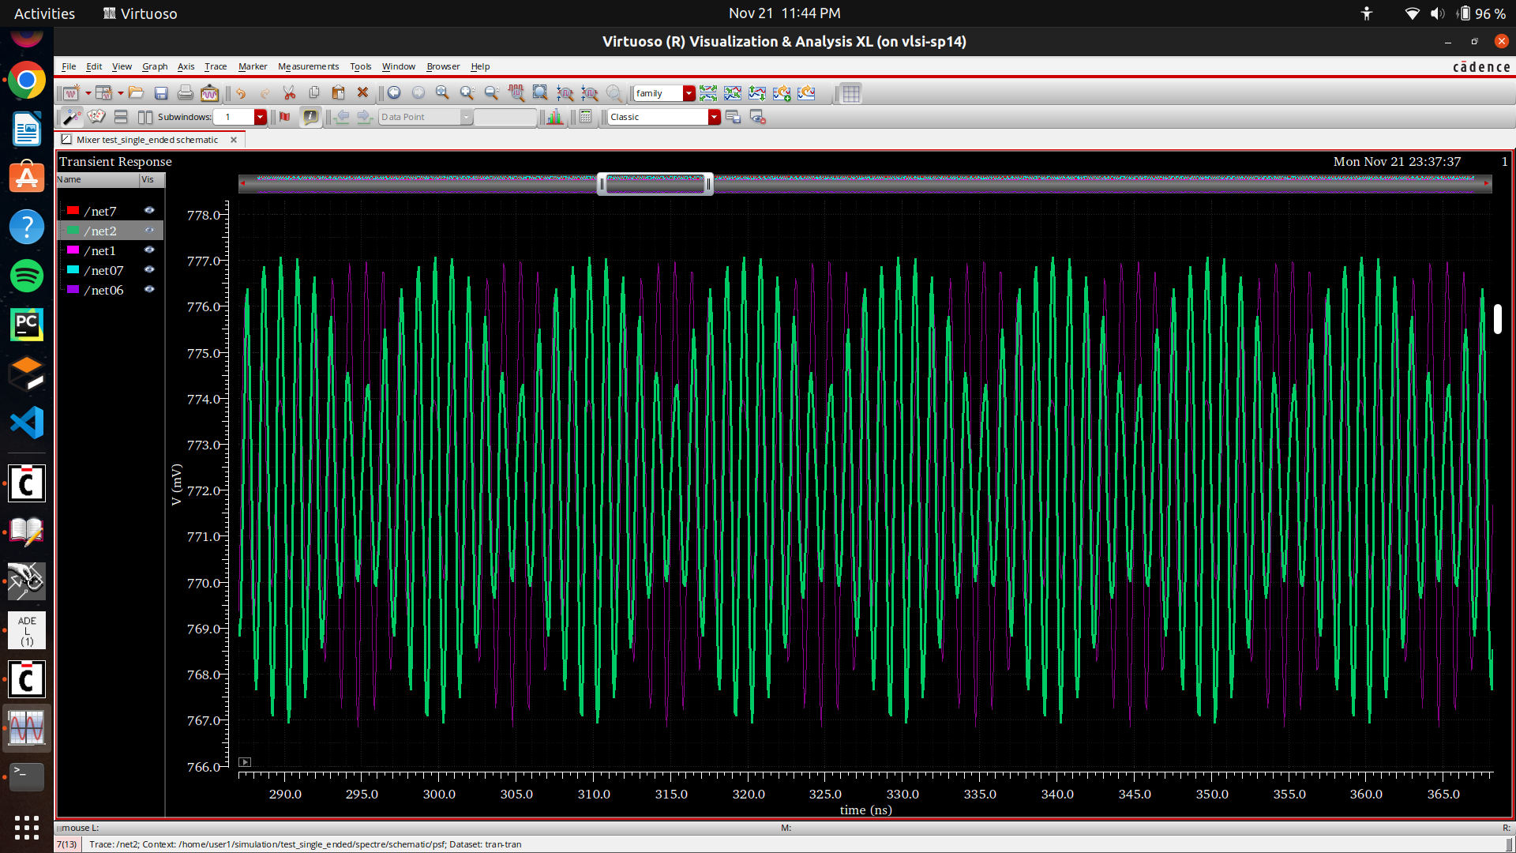
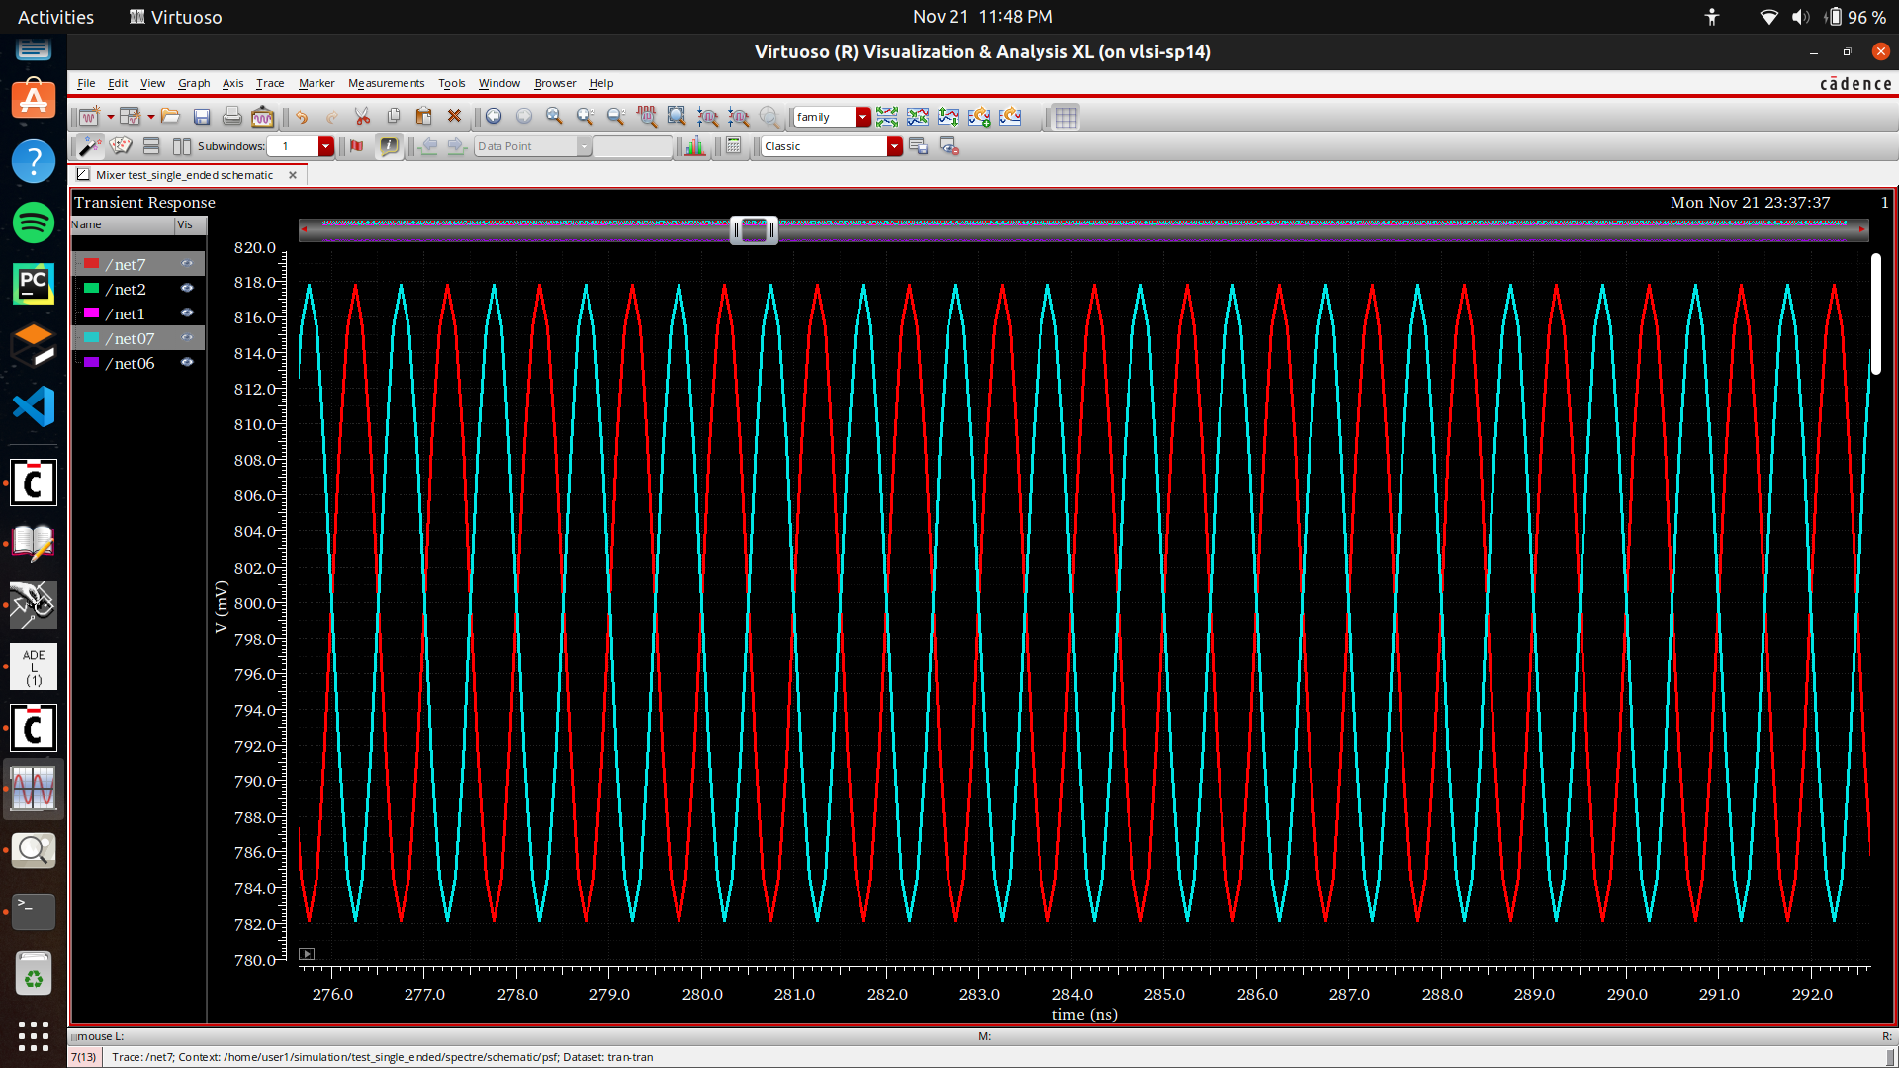
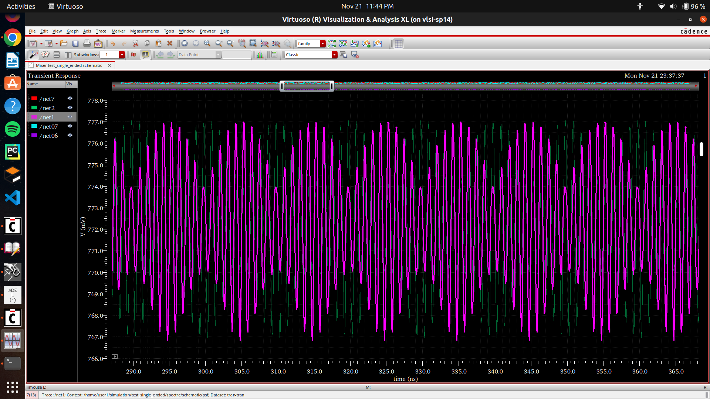
Input - RF, LO Signals & Output - IF signal (differential)

Slide 24
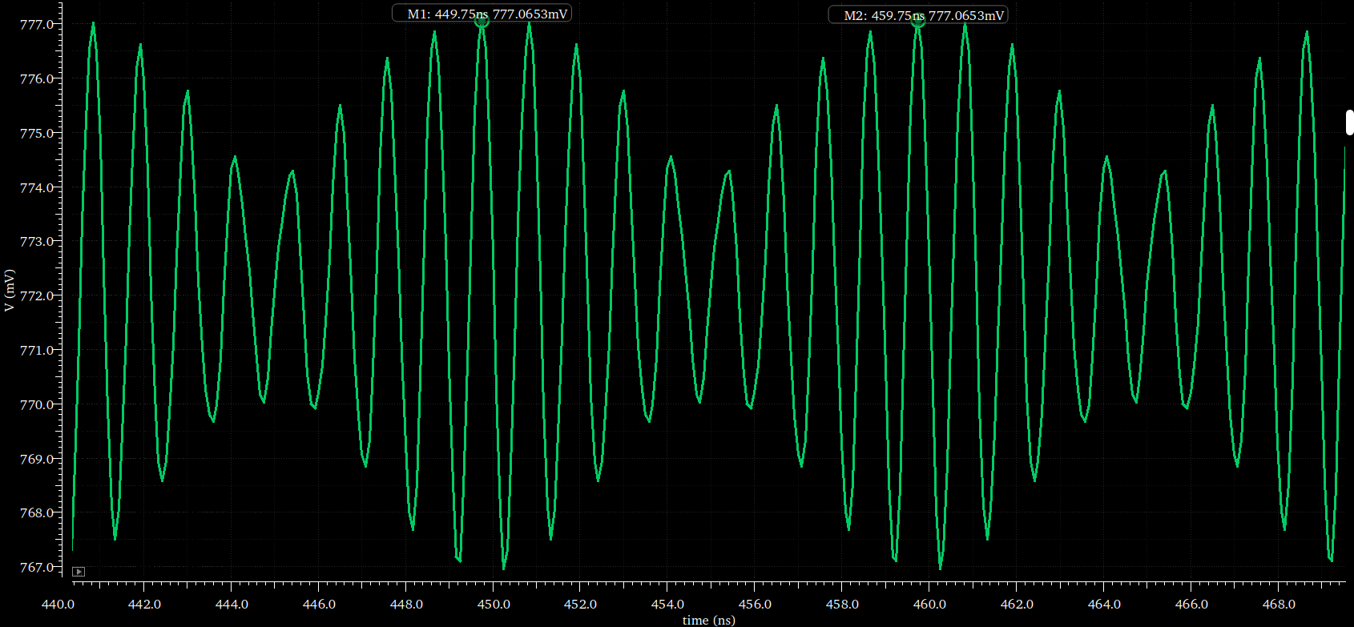
The output signal frequency is - 0.1 GHz, or 100 MHz

Slide 25
Double balanced mixer

Slide 26
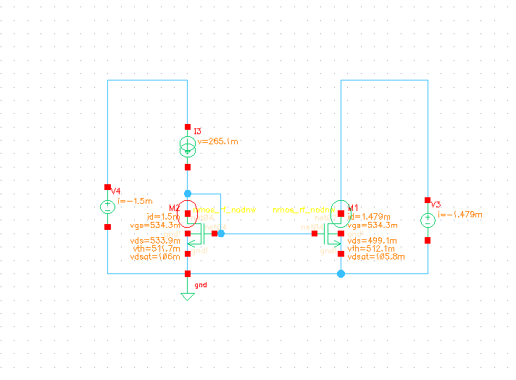
nmos_rf_nodw from TSMC 65 nm library in Cadence
I = 1.5 mA
I_{tail} = 1.479 mA
V_{dc} (M0)= 800 mV
V_{ds} (M1)= 500 mV
Current mirror topology circuit implemented in virtuoso
Notes:
Q. Why current is not exactly the same in both the nMOS ?
Ans. We are providing same amount of V_{gs} to both of the MOS transistors, but the V_{ds} of them is not same, there will be differences in the current due to channel length modulation, which suggests that I_{ds} is also dependent on the V_{ds}of the MOSFET.
Q. How does a current mirror work ?
Ans. We keep one nMOS in diode connected mode and then set the drain current with a current source. The V_{gs} and V_{ds} will automatically adjust themselves accordingly to provide the drain current of I_{ds} and the drain current through the other nMOS will also be identically the same,because we have the same V_{gs} provided we also give the same V_{ds} to the nMOS.

Slide 27
Current mirror specifications
2 n-MOSFETs, whose gate terminals are connected, and we are pumping current into M2, and we see we get the drain source I_{DS} current mirrored of the MOSFET M1.
Specifications for MOSFETs in Current mirror :
Number of fingers in MOSFET - 32
Channel length per finger of MOSFET - 200 nm
Width per finger of MOSFET - 6 μm
Accuracy of mirroring current = 98.6 %
The same specs are used for MOSFETs in current mirrors in all the circuits.

Slide 28
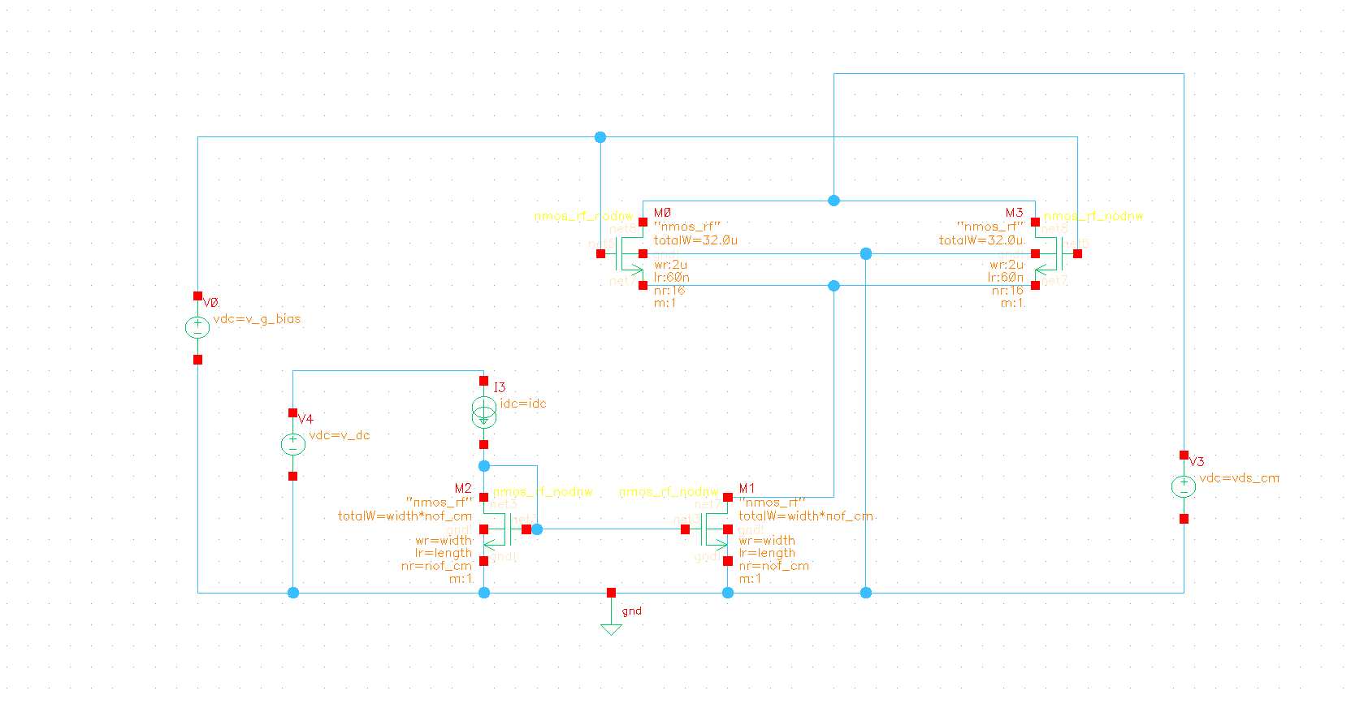
nmos_rf_nodw from TSMC 65 nm library in Cadence
I = 1.5 mA
I_{tail}= 1.337 mA
I_{ds}= 668.3 μA
V_{ds} (M0)= 1 V
V_{ds} (M1)= 296.4 mV
V_{ds} (M3, M2)= 201.9 mV
Current mirror topology circuit for tail current with 2 nMOSFETs above implemented in virtuoso

Slide 29
Current mirror topology circuit for tail current with 2 nMOSFETs
2 n-MOSFETs, whose gate terminals are connected, and we are draining tail equal current from both the MOS transistors, which is provided by the Current mirror.
Specifications for MOSFETs in Stage 1 :
Number of fingers in MOSFET - 16
Channel length per finger of MOSFET - 60 nm
Width per finger of MOSFET - 2 μm
Accuracy of mirroring current = 89.1 %

Slide 30
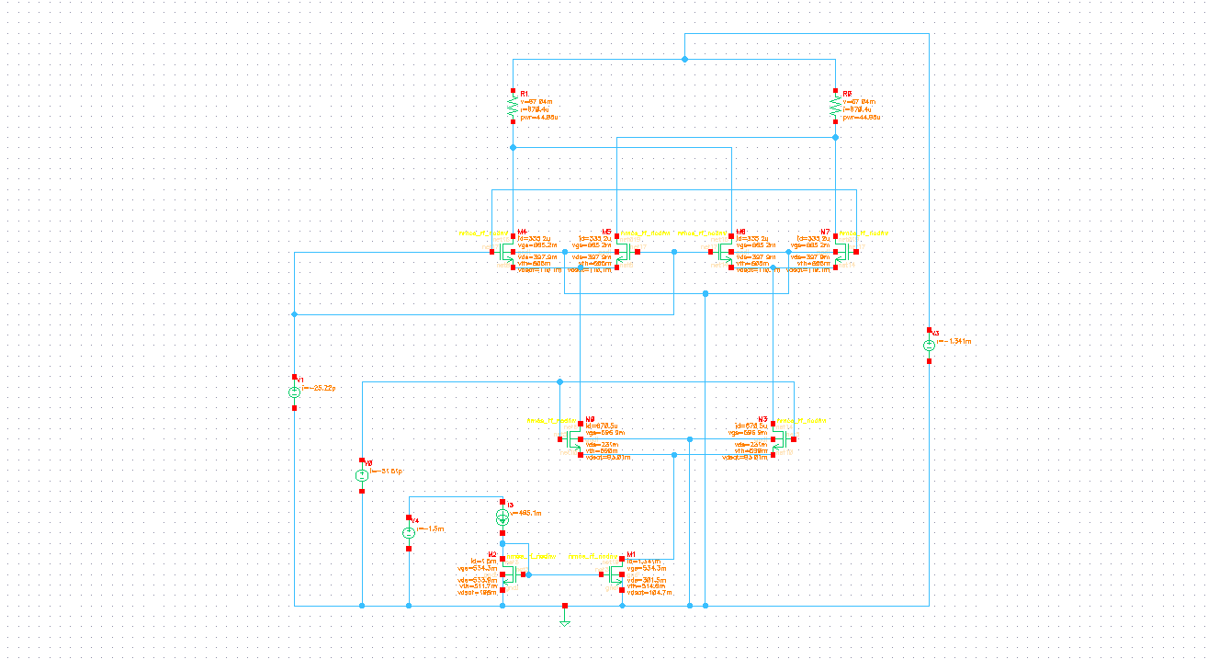
nmos_rf_nodw from TSMC 65 nm library in Cadence
I = 1.5 mA
I_{tail}= 1.341 mA
I_{ds}= 670.5 μA
I_{ds}= 335.2 μA
V_{ds} (M0)= 1 V
V_{ds} (M1)= 301.5 mV
V_{ds} (STAGE 1)= 231 mV
V_{ds} (STAGE 2)= 397.9 mV
V_{ds} (resistors)= 67.04 mV
Current mirror topology circuit for tail current with 2 nMOSFETs in stage 1 and 4 nMOSFETs in stage 2 above implemented in virtuoso

Slide 31
Current mirror topology circuit for tail current with 2 nMOSFETs
2 n-MOSFETs in stage 1, 4 n-MOSFETs in stage 2 whose gate terminals are connected, and we are draining tail equal current from both the MOS transistors, which is provided by the Current mirror.
Specifications for MOSFETs in Stage 2 :
Number of fingers in MOSFET - 4
Channel length per finger of MOSFET - 60 nm
Width per finger of MOSFET - 2 μm
Accuracy of mirroring current = 89.6 %
Resistor values used above stage 2 nMOS are - 100Ω

Slide 32
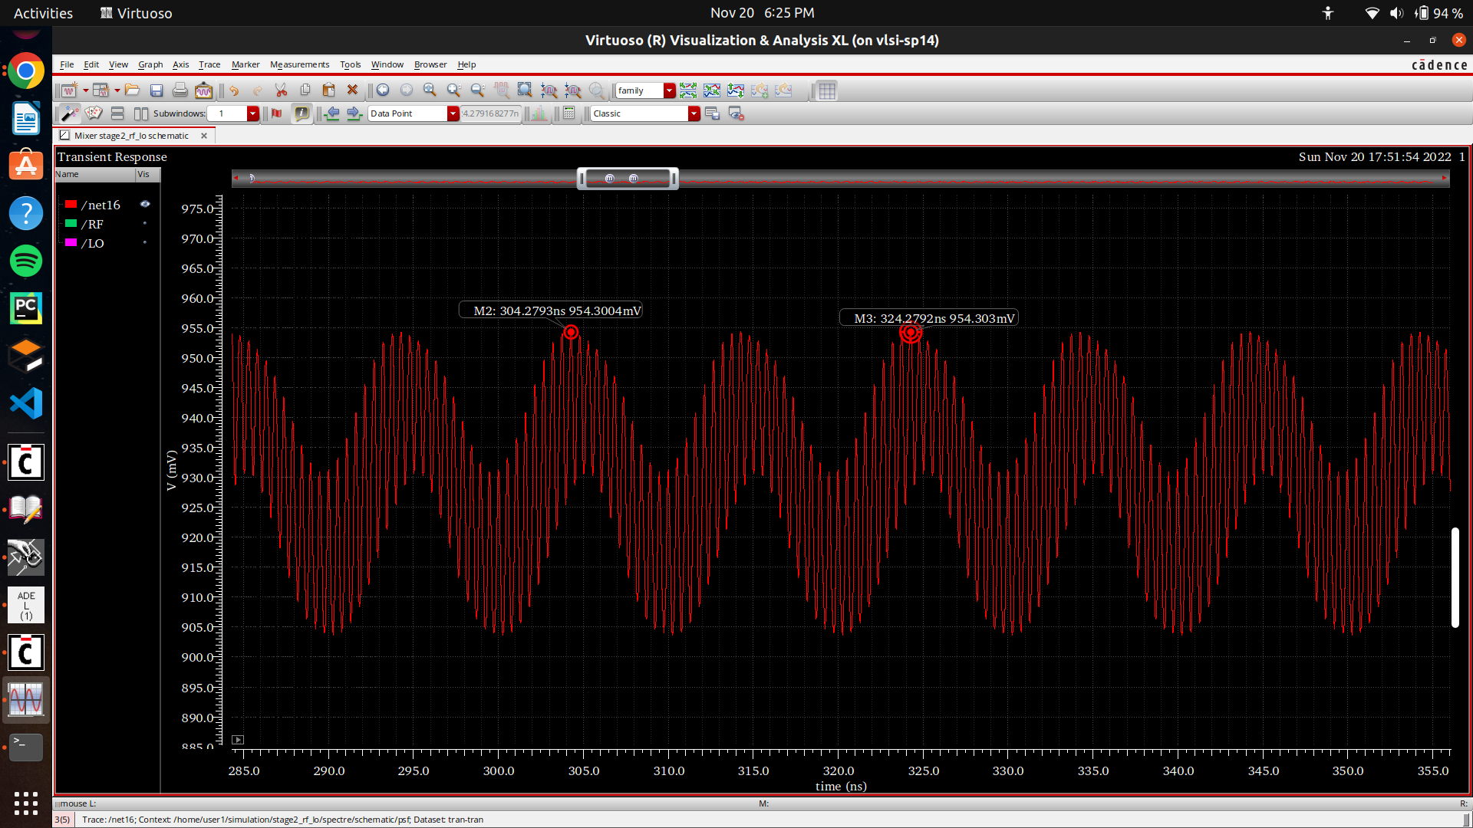
Period of the output wave :
For 2 cycles after the output has reached steady state,
T1 = 304.27 ns
T2 = 324.27 ns
Period = 0.1 GHz
Output of transient analysis of the mixer - Intermediate frequency(IF)

Slide 33
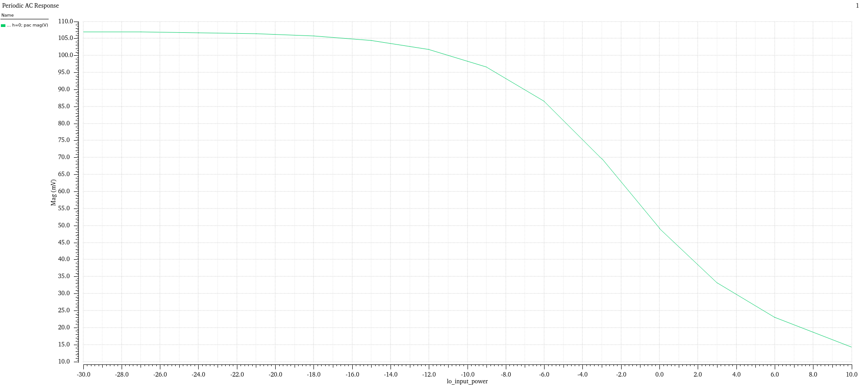
IN PROGRESS
Output magnitude vs LO power swept from -30 to 10 dBm

Slide 34
Learning Outcomes
Basics of MOSFET based circuits - current mirrors, balun for converting single ended inputs into differential inputs.
Basic rectifier topologies for RF energy harvesting.
Basics in RF receiver and blocks in RF receivers.
RF mixer block - characteristics of mixers, upconversion and downconversion mixers, balanced and unbalanced mixers, non-linear device based mixers, switch based mixers, active and passive mixers, CMOS gilbert cell mixer topologies and diode ring mixer, ideal balun test bench.
Cadence Virtuoso and spectre software for simulation of mixer topologies.

Slide 35
Future plans for the project
Voltage Conversion Gain versus the LO Signal Power.
Voltage Conversion Gain versus RF Frequency.
Port-to-Port Isolation among RF, LO, IF ports.
Power Dissipation, Large Signal Power (Voltage) Conversion Gain (QPSS).
1dB Compression and IIP3 (QPSS & QPAC)

Slide 36
References
Double balanced mixer
Single balanced mixer
CMOS rectifier
Tutorial for mixers
Theory of mixers
CMOS rectifiers paper on 45 nm CMOS technology

Slide 37
THANK YOU

